Slide 1
Comprehensive SEO Audit & Optimization For Organic Traffic Growth
-Yashwanthini Aishwariya B

Slide 2
The selected company is Adobe (https://www.adobe.com/in/) for the SEO audit project
Adobe is a renowned american multinational computer software company headquartered in san jose, California.
It's a leading provider of creative, marketing, and document management solutions.
Adobe is synonymous with innovation and has played a pivotal role in shaping the digital landscape.

Slide 3
About the services of the company
Photoshop: Industry-standard image editing software.
Illustrator: Vector graphics editor for creating logos, illustrations, and artwork.
Premiere Pro: Professional video editing software.
After Effects: Motion graphics and visual effects software.
InDesign: Page layout and publishing software.
XD: UX/UI design tool.
Animate: Animation software.
Lightroom: Photo editing and organization software.
Audition: Audio editing and mixing software.
Dreamweaver: Web development software.
Dimension: 3D design and rendering software.
Acrobat Pro DC: PDF creation, editing, and signing software.
Adobe Express: All-in-one design, video, photo, and PDF app.
Adobe Firefly: AI-powered creative tools.

Slide 4
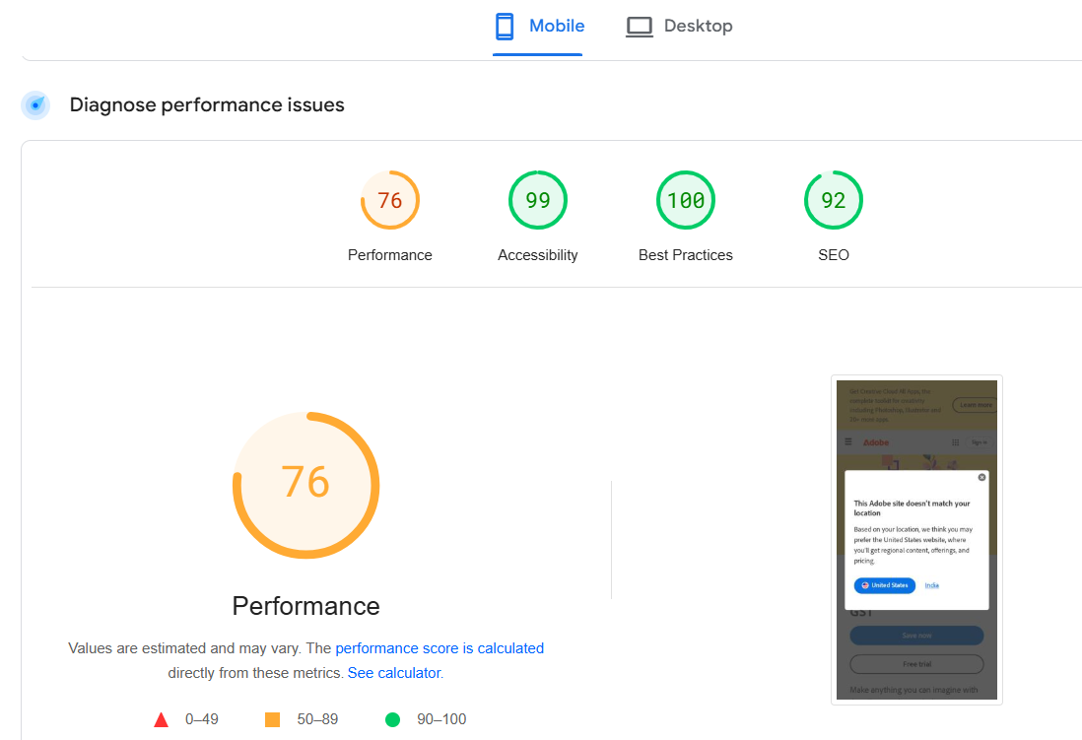
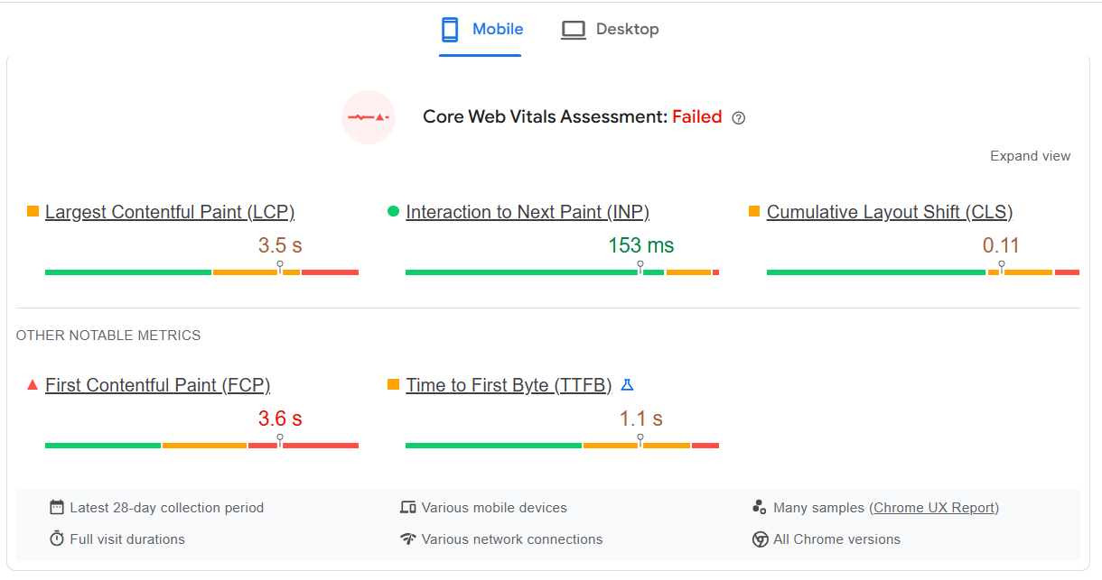
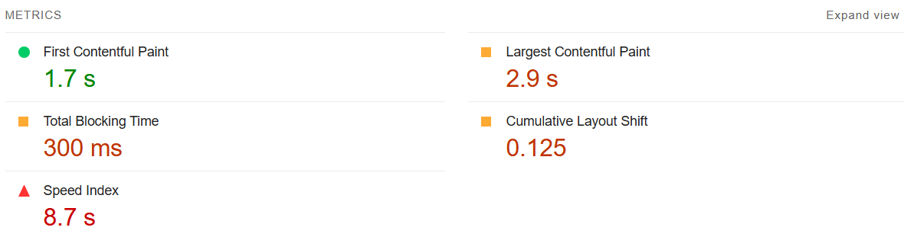
Task -1
Initial audit

Slide 5
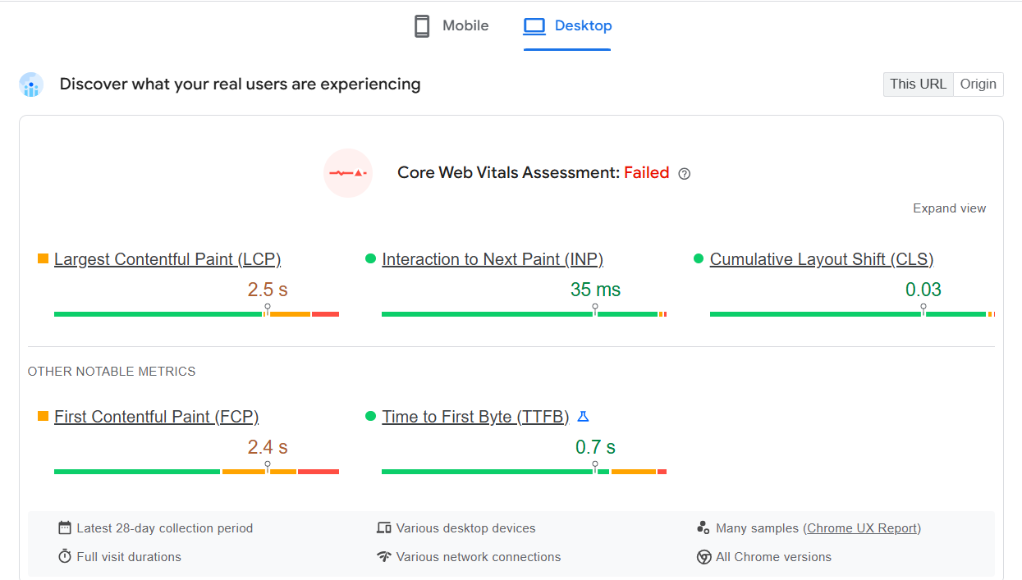
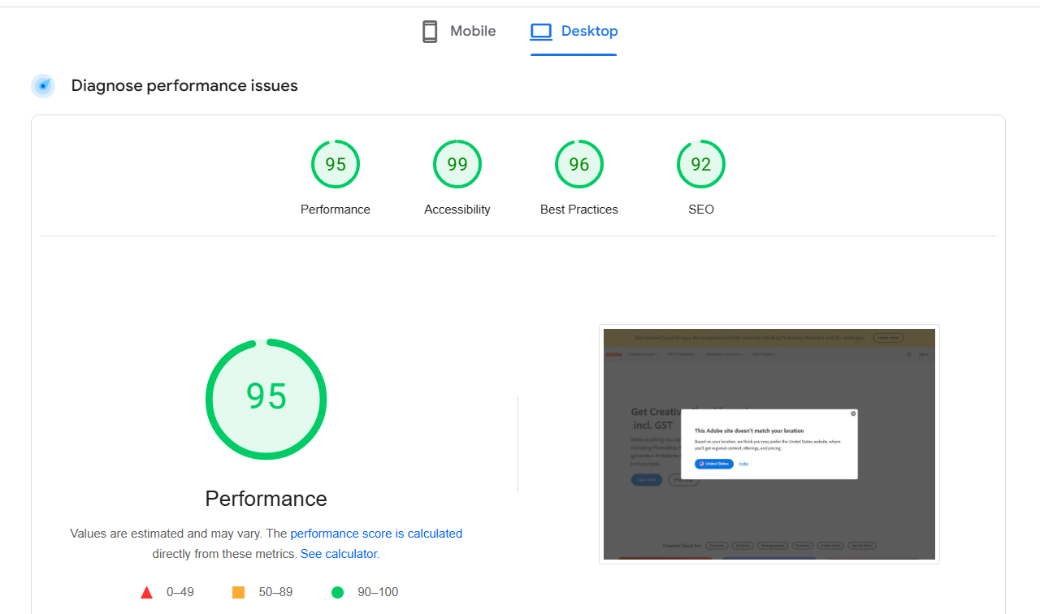
Current performance
It takes long time to load the main content and there exists the visual stability issues. Performance is better
Strength
effectively communicates the core web vitals assessment in a simple and easy-to-understand manner.
The use of color-coded bars and icons makes it easy to quickly identify the performance metrics.
It has good performance, accessibility, SEO and best practices
Weakness
It doesn't provide any context about the specific website being assessed or the industry it belongs to.
only shows a snapshot of performance data. It's unclear how the website's performance has changed over time.

Slide 6
Task 2
Keyword Research
Manufacturing
S.NO | KEYWORDS | SEARCH VOLUME
1 | Manufacturer | 110 k
2 | Manufacturing | 60.5k
3 | Lace manufacturers india | 49.5k
4 | Manufacturers | 27.1k
5 | manufacture | 27.1k

Slide 7
Task 2
Acrobat sign
S.NO | KEYWORDS | SEARCH VOLUME
1 | Adobe acrobat sign | 4.4k
2 | Adobe acrobat sign in | 4.4k
3 | Acrobat sign | 1.9k
4 | Signing in adobe acrobat | 1.9k
5 | Signing into adobe acrobat | 1.3k

Slide 8
Task 2
Retail
S.NO | KEYWORDS | SEARCH VOLUME
1 | Chain store | 30.1k
2 | Retail | 74.5k
3 | Retail store | 49.5k
4 | Retail sales | 8.1k
5 | Visual merchandising | 8.1k
Competitor analysis
The website like Autodesk, corel and affinity are considered as its main competitors which use optimized keywords in their pages.
The keywords are optimized based on the content used in it.

Slide 9
Task 3
The selected pages in adobe website are:
Manufacturing
Adobe Acrobat sign
Retail

Slide 10
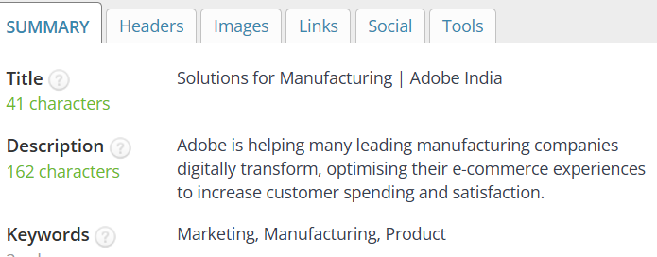
Manufacturing https://business.Adobe.Com/in/industries/manufacturing.Html
target keyword - manufacturing
Target keyword and meta description are optimized with proper keyword
Proper keywords are used in content and headings.
usage of 3 internal links
Image are optimized properly

Slide 11
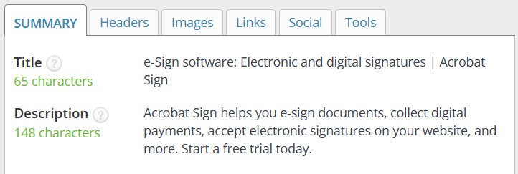
Adobe acrobat sign https://www.Adobe.Com/in/sign.Html
Target keyword - Adobe acrobat sign
Target keyword and meta description are optimized with proper keyword
Keyword is used more than 5 times.
The page is overstuffed with keywords
3. Usage of 2 internal links
4. Image are optimized properly

Slide 12
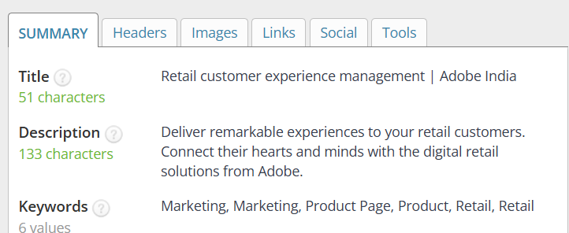
Retail - Https://business.Adobe.Com/in/industries/retail.Html
Target keyword : retail
Target keyword and meta description are optimized with proper keyword
Keyword is used more than 5 times.
The page is overstuffed with keywords
3. There is neither internal or external link.
4. Image are optimized properly

Slide 13
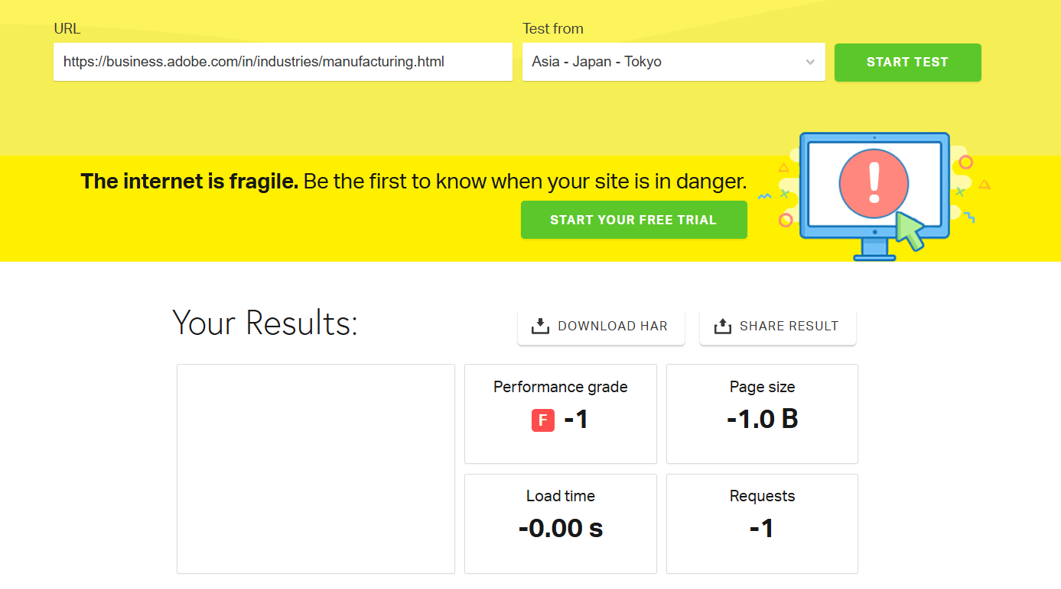
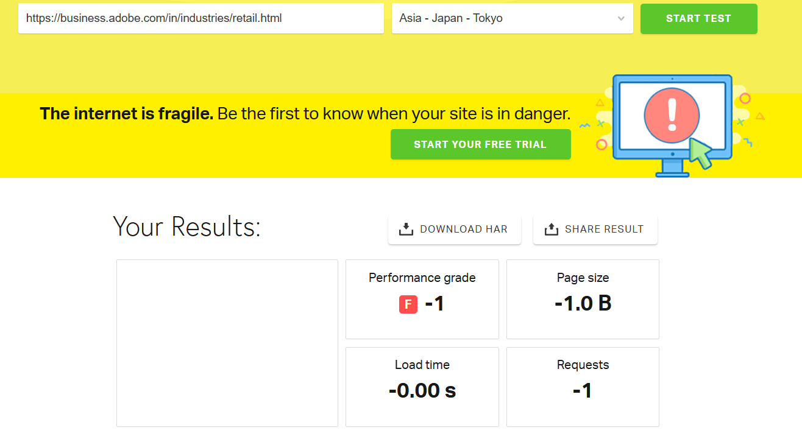
Task - 4
Manufacturing
Issues Extremely Low Performance Grade (F-1) Large Page Size (-1.0B) Zero Load Time (-0.00 s) Minimal Requests (-1)
Recommendations Optimized Compression Improve Server Response Time Minify CSS and JavaScript
Retail

Slide 14
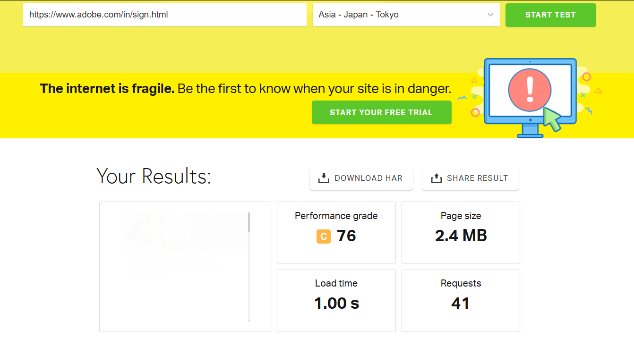
Issues Moderate Performance Grade (C-76) large Page Size (2.4 MB) Load Time (1.00 s) Requests (41)
Recommendations Optimized image Leverage browser caching Optimize the server configuration and use CDN

Slide 15
Task-5
A content strategy plan based on keyword research
Global supply chain management
The future of manufacturing
The role of small and medium-sized manufacturers
Quality control and assurance in manufacturing
The role of automation in manufacturing
Retail Operations Management
Customer Experience Management in Chain Stores
Retail Analytics: Leveraging Data to Drive Growth
The Impact of Social Media on Retail
In-Store Marketing and Promotions
Creating, Editing, and Sharing PDFs with Adobe Acrobat DC
Securing Your Documents with Adobe Acrobat
Automating Document Workflows with Adobe Acrobat
Best Practices for Using Adobe Acrobat Sign
Troubleshooting Common Adobe Acrobat Issues

Slide 16
Task-6
Off page SEO plan and strategy
Competitor Analysis:
Analyze the competitors' backlink profiles and identify opportunities to outperform them.
Assess the current backlink profile to identify toxic or low-quality backlinks.
Content Creation Strategy:
Create high-quality, informative, and engaging content that is optimized for search engines and focus on creating content that is shareable and linkable.
Link Building Strategy:
Develop a systematic approach to building high-quality backlinks from authoritative websites.
Prioritize guest posting, outreach, and broken link building.

Slide 17
Brand Building Strategy:
Focus on building a strong brand reputation through social media, public relations, and online reviews.
Engage with the audience on social media and respond to comments and messages promptly.
Monitoring and Analysis:
Track the website's performance using tools like Google Analytics and Google Search Console.
Monitor the backlink profile and identify any negative backlinks.
Backlink Audit:
Regularly analyze the keyword rankings and make necessary adjustments to the SEO strategy.

Slide 18
Project Deliverables
1. Performance of the selected website is analysed based on the SEO audit
2. Identified the relevant keyword with high search volume
3. On page website audit is done for three different pages of the website and Semrush is used as tool, through which the used keywords, meta descriptions and images are analysed
4. Technical SEO audit is done to analyse the website’s performance and recommendations are provided to overcome the identified issues
5. Topics are listed as a strategic plan to improve the content
6. Off page SEO plan and strategy are stated to improve the ranking

Slide 19
Thank you

